Slide 1
VEHICLE SPEED MONITORING AND CONTROLLING USING CAN PROTOCOL
Presented by
1.Akash Tenkale
2.Shubham Joshi
3. Mohit Dongre
4.Manmath Mitkari

Slide 2
CONTENT
Introduction
Advantages
Accessories and Technologies
Block diagram
Description

Slide 3
AIM : Designing and implementing a system which can monitor and control
speed of vehicle using CAN protocol

Slide 4
INTRODUCTION
This project here aims in designing a prototype system which helps in monitoring the real time parameters of vehicle using CAN protocol.
This system helps in achieving effective communication between transmitter and receiver modules(Dash board) using multiple sensors to monitor parameters like engine temperature, Obstacle detection(PAS system).
The modules interfaced with the sensors for this system are, Temperature sensor capable of detecting engine heat, Ultrasonic sensor for obstacle detection and speed controlling, Infrared sensor for detecting the speed.
A CAN transceiver is used to establish communication between two microcontrollers measuring & displaying continuously the above real time parameters on a LCD (dash board).

Slide 5
WHY CAN ?
CAN DEVICE 1
CAN DEVICE 2
CAN DEVICE N
CAN_H
CAN_L

Slide 6
CAN ADVANTAGE :
Excellent error handling
Fault confinement
High speed, real time communication
Simple transmission medium
Provide noise immunity in an electrically noisy environment

Slide 7
BOARD USED : STM32F407G-DISC1 DISCOVERY BOARD * 2
USED TECHNOLOGIES : CAN ( CONTROLLER AREA NETWORK) PROTOCOL, EMBEDDED C
USED ACCESSORIES :
TEMPERATURE SENSOR : When vehicle is overspeeding continuously.
INFRARED SENSOR : To detect the speed of vehicle.
ULTRASONIC SENSOR : To detect the speed and distance of obstacle approaching.
BUZZER : Will blow beep sound when overspeed done continuously.
LCD DISPLAY : Will display all the speed readings and precautionary messages.

Slide 8
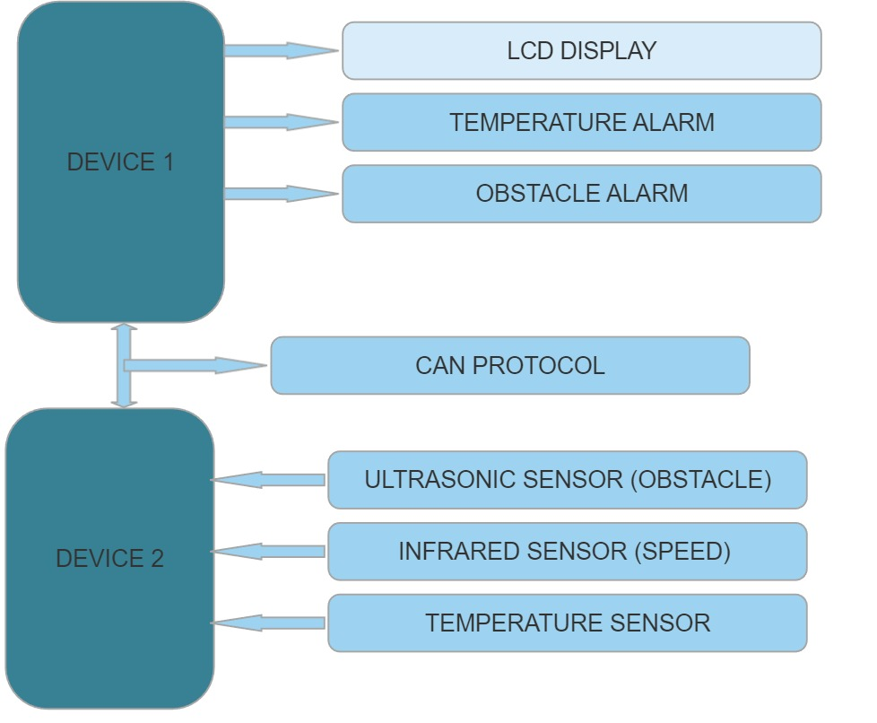
Block diagram of vehicle speed monitoring and controlling using CAN communication

Slide 9
The above figure is block diagram of CAN vehicle control system.It consists of two devices(nodes).
ARM as one node (Engine Control Module) which controls the vehicle status with various sensors. Another ARM is used as second node to receive the inputs of vehicle status.
The communication between these sensors is done by using CAN controller.
Device two controller receives the signals from vehicles like temperature, ultrasonic sensor and IR speed detector etc., sends it to device one controller with high speed rate.
Device one controls the status of vehicle and sends the feedback to operator panel by providing digital information’s via LCD display and alarms. Here Operator interface is digital type. By this operator can easily see the signals and able to control the vehicle.

